Slide 1
Chapter 13
The Presidency
American Democracy Now, 7th edition
Brigid Callahan Harrison
Jean Wahl Harris
Michelle D. Deardorff
Copyright 2022 © McGraw Hill LLC. All rights reserved. No reproduction or distribution without the prior written consent of McGraw Hill LLC.

Slide 2
Presidential Elections
Campaigns are opportunities for voters to familiarize themselves with the policy stances and personal traits of candidates.
Votes tallied on Election Day determine which presidential candidate’s slate of electors will cast their ballots, in accordance with state law.
Presidential candidate today needs a simple majority of electoral votes to win the presidency.
Winner takes the oath of office January 20.

Slide 3
Presidential Roles and Responsibilities
Newly elected presidents quickly discover that the presidential office requires a variety of functions to be performed each day.
Many are closely related to their constitutionally prescribed duties, including commander in chief of the U.S. armed forces and other duties related to the president’s role as chief diplomat.
Presidents must also conduct the “politics” of the job, interacting with Congress and serving as leader of their party.

Slide 4
The President’s Role in Congressional Agenda Setting 1
Presidents can influence Congress by lobbying its members to support or oppose pending legislation and by defining the congressional agenda in the annual presidential State of the Union message.
Presidents submit the budget for the entire federal government to Congress annually.
One of the most important legislative tools at a president’s disposal is the authority either to sign legislation into law or to veto it.

Slide 5
Chief of State
Function of chief of state is similar to the ceremonial role played by the constitutional monarch in parliamentary systems such as Great Britain’s.
In the United States, the role of symbolic leader of the nation enhances the president’s image and authority and promotes national unity.

Slide 6
The President’s Role in Congressional Agenda Setting 2
Modern presidents are generally much more likely to veto legislation than their predecessors were.
Presidents are more likely to exercise veto power when their party isn’t the majority in Congress.
Presidential signing statement is a written message that the president issues upon signing a bill into law.

Slide 7
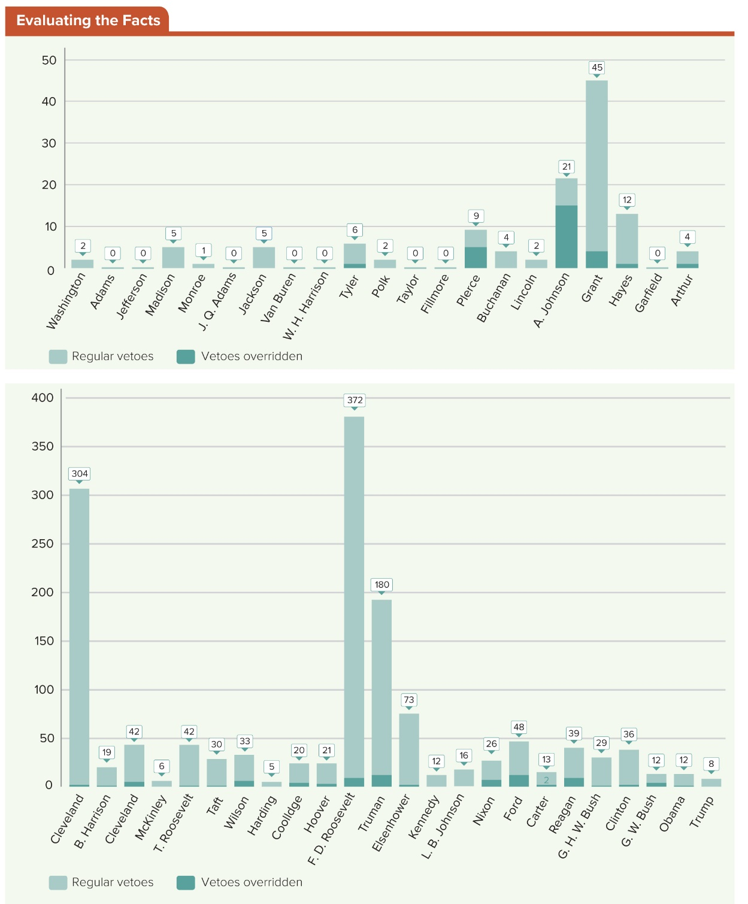
Figure 13.1 Presidential Vetoes, 1789 to 2020
Modern presidents are generally much more likely to veto legislation than their predecessors were. One exception was the presidency of Franklin D. Roosevelt. During Roosevelt’s 12-year term, he issued 372 vetoes, or 12 percent of all presidential vetoes.
Access the text alternative for slide images.

Slide 8
Manager of the Economy 1
Presidents have numerous tools at their disposal that powerfully influence the country’s economic performance.
By submitting a budget to Congress, presidents shape where federal tax dollars are spent, and thereby set the economic priorities of the legislative agenda.

Slide 9
Manager of the Economy 2
Presidents also help to establish the regulatory and economic environment in which businesses must operate.
Central in presidents’ oversight of economic performance is the appointment of members of “the Fed” (Federal Reserve Board) and the Fed chair, who play a crucial role in managing the economy.

Slide 10
Chief Diplomat
President (along with advisers) shapes and administers the nation’s foreign policy.
As chief diplomat, the president, in conjunction with his or her staff, negotiates treaties and other international agreements with foreign countries.
President has the authority to enter into an executive agreement with other nations.
Constitution also empowers the president to appoint ambassadors to other nations.

Slide 11
Civilian Leader of the Military
As commander in chief, the president is the supreme military commander of the U.S. Army, Navy, Air Force, Marines, and Coast Guard.
Counseled by advisers, the president decides when to send troops into battle (although only Congress can formally declare war) and sets military strategy in times of both peace and war.

Slide 12
Party Leader
As chief of one of the two main parties, the president is a symbolic leader for the party members and asserts influence in the party’s operations by selecting the national party chair and serving as the party’s premier fund-raiser.
President also acts as party head in the day-to-day operations of the executive branch.
Finally, at the end of a president’s term, the president likely campaigns on behalf of the party’s new presidential nominee.

Slide 13
Chief Executive
President appoints the executive branch leaders.
Secretaries (top administrators) of the cabinet—the 15 departments of the federal government.
Heads of other federal government agencies charged with developing and implementing policy.
Other staff members and numerous advisers, including staff in the Executive Office of the President.
President determines how the bureaucracy will implement the laws Congress has passed and which will be emphasized.

Slide 14
The President and the Executive Branch
As chief executive, the president is constitutionally charged with ensuring that the “laws be faithfully executed.”
Today, this responsibility means that the president oversees a bureaucracy of more than four million government employees, including the members of the military, while presiding over an astonishing annual federal budget of nearly $4 trillion.

Slide 15
The Vice President’s Role
Media and the public tend to ignore the vice presidency and to marginalize the responsibilities of the second-in-command.
Vice presidents have an enormously important function.
First in the line of succession to the presidency if the president should die or become incapacitated.
Eight presidents have died while in office.

Slide 16
The Vice President’s Job
Many vice presidents serve a largely ceremonial function.
But vice presidents may have more substantive responsibilities, depending upon their skills and the needs of the administration.
Example: Dick Cheney.

Slide 17
Choosing a Vice President
In selecting a vice-presidential running mate, presidential candidates weigh several considerations.
Would-be presidents strive for a balanced ticket, selecting a running mate who brings diversity.
Ideology, geographic region, age, gender, race, or ethnicity.
May base their vice-presidential selection on their own perceived shortcomings.

Slide 18
The Cabinet
Since George Washington’s presidency, every president has depended on the advice of a cabinet, the group of experts chosen by the president to serve as advisers on running the country.
Each president may also designate cabinet rank to other advisers whose agencies are not permanent cabinet departments.
Presidential cabinets have become more diverse.
President Trump’s is less diverse than those of recent presidents before his tenure.

Slide 19
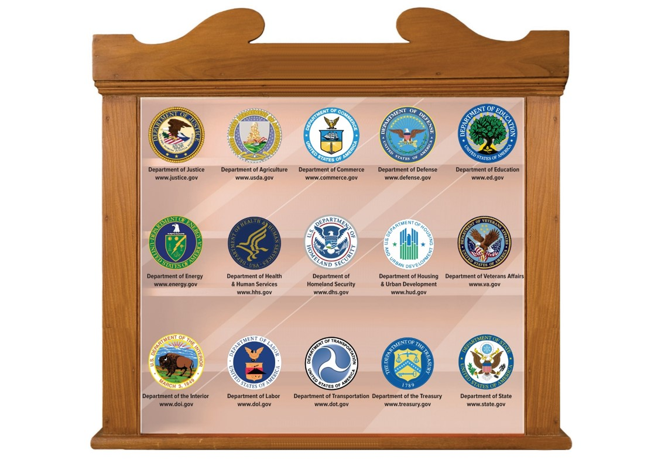
Figure 13.2 The Departments of the President’s Cabinet
Access the text alternative for slide images.

Slide 20
Table 13.1 Women and Minorities Appointed to Presidential Cabinets
PRESIDENT | NUMBER OF WOMEN CABINET MEMBERS | NUMBER OF MINORITY CABINET MEMBERS | TENURE
Trump | 6 | 4 | 2017 to 2021
Obama | 14 | 15 | 2009 to 2017
G. W. Bush | 7 | 10 | 2001 to 2009
Clinton | 13 | 11 | 1993 to 2001
G. H. W. Bush | 4 | 3 | 1989 to 1993
Reagan | 4 | 2 | 1981 to 1989
Carter | 4 | 1 | 1977 to 1981
Ford | 1 | 1 | 1974 to 1977
Nixon | 0 | 0 | 1969 to 1974
Johnson | 0 | 1 | 1963 to 1969
Kennedy | 0 | 0 | 1961 to 1963
Eisenhower | 1 | 0 | 1953 to 1961
Truman | 0 | 0 | 1945 to 1953
F. Roosevelt | 1 | 0 | 1933 to 1945
Table divided into four columns summarizes women and minorities appointed to presidential cabinets. The column headers are marked from left to right as: President, number of women cabinet members, number of minority cabinet members, and tenure.
SOURCES: Brigid C. Harrison, Women in American Politics: An Introduction (Belmont, CA: Wadsworth Publishing, 2003); the Center for the American Woman and Politics, National Information Bank on Women in Public Office, Eagleton Institute of Politics, Rutgers University.

Slide 21
The Executive Office of the President
Offices, councils, and boards that compose the Executive Office of the President (EOP) help the president carry out the day-to-day responsibilities of the presidency.
Similarly assist the First Lady and the vice president in their official activities.
EOP also coordinates policies among different agencies and departments.

Slide 22
The White House Office
White House Office (WHO) staff members develop policies favored by the presidential administration and protect the president’s legal and political interests.
Key WHO staff include:
Chief of staff (presidential adviser and WHO manager).
Press secretary (spokesperson to the media).
White House counsel (lawyer).
President’s secretary and appointments secretary are also influential WHO employees.

Slide 23
National Security Council
National Security Council (NSC) advises presidents on key national security and foreign policy decisions and assists in the implementation of those decisions.
President officially chairs the NSC.
Other regular members include the vice president, the secretary of defense, the secretary of state, the secretary of the treasury, and the assistant to the president for national security affairs—often called the National Security Advisor.

Slide 24
Office of Management and Budget
Chief responsibility of the Office of Management and Budget (OMB) is to create the president’s annual budget, submitted to Congress each January.
Director of the OMB, a presidential appointee, has a staff of about six hundred career civil servants.
Once Congress approves the budget, the OMB manages the budget’s execution by federal departments and agencies.

Slide 25
Presidential Succession
Presidential succession is determined by the Presidential Succession Law of 1947.
But sometimes incapacitation other than death prevents presidents from fulfilling their duties.
In such cases, the Twenty-Fifth Amendment, ratified in 1967, determines the course of action.

Slide 26
When the President Dies in Office
When the president dies, the course of action is clear in most cases: the vice president assumes the presidency.
Presidential Succession Law of 1947 determines presidential succession if the vice president also dies or is unable to govern.

Slide 27
Table 13.2 The Line of Presidential Succession
(1) Vice president (2) Speaker of the House of Representatives (3) President pro tem of the Senate (4) Secretary of state (5) Secretary of the treasury (6) Secretary of defense (7) Attorney general (8) Secretary of the interior (9) Secretary of agriculture (10) Secretary of commerce (11) Secretary of labor (12) Secretary of health and human services (13) Secretary of housing and urban development (14) Secretary of transportation (15) Secretary of energy (16) Secretary of education (17) Secretary of veterans affairs (18) Secretary of homeland security
Table summarizes the line of presidential succession.

Slide 28
When the President Cannot Serve: The Twenty-Fifth Amendment
If a president believes he or she is unable to carry out the duties of the office, the president must notify Congress, and the vice president becomes the acting president until the president can resume authority.
If the president is incapable of notifying Congress, the VP and a majority of the cabinet notify Congress, and the VP becomes the acting president.
If a question arises as to whether the president is fit to reassume the duties of office, a two-thirds vote of Congress allows the acting president to remain.

Slide 29
Sources of Presidential Power
Framers granted the president both expressed powers and inherent powers in the Constitution.
Congress grants presidents additional powers, called statutory powers, through congressional action.
Additional presidential powers have emerged over time, such as emergency powers and informal powers bestowed through electoral mandate, presidential popularity, or unified public opinion on a particular issue or course of action.

Slide 30
The Constitution: Expressed Powers 1
Primary source of presidential power comes from the Constitution in the form of the expressed powers, which are those enumerated in the Constitution.
Expressed powers outlined in the Constitution provide a framework for presidential responsibilities and an outline of presidential power.

Slide 31
The Constitution: Expressed Powers 2
Article II, Sections 2 and 3.
Commander in chief of the armed forces.
Appoint executive department heads, ambassadors, Supreme Court justices, people to fill recess vacancies, etc.
Grant pardons, except in cases of impeachment.
Enter into treaties, with two-thirds consent of the Senate.
Give the State of the Union address to Congress.
Convene the Congress.
Receive ambassadors of other nations.
Commission all officers of the United States.

Slide 32
The Constitution: Inherent Powers
Take care clause states that “the executive Power shall be vested in a President of the United States of America” and that the president “shall take Care that the Laws be faithfully executed.”
On the basis of that clause, presidents throughout U.S. history have asserted various inherent powers, which are powers that are not expressly granted by the Constitution but are inferred.

Slide 33
Statutory Powers
Constitution’s expressed and inherent powers provided a foundation for presidential power that has evolved over time.
Those powers have been supplemented by statutory powers—powers explicitly granted to presidents by congressional action.

Slide 34
Special Presidential Powers
Presidents also have special powers that have evolved from various sources, including the Constitution, Supreme Court decisions, and congressional statutes.
These powers, which numerous presidents have exercised, have come to be regarded as accepted powers and privileges of the presidency.
They include executive orders, emergency powers, and executive privilege.

Slide 35
Executive Orders
President has the power to issue executive orders that have the force of law.
In general, executive orders:
Direct the enforcement of congressional statutes or Supreme Court rulings.
Enforce specific provisions of the Constitution.
Guide the administration of treaties with foreign governments.
Create or change the regulatory guidelines or practices of an executive department or agency.

Slide 36
Emergency Powers
Broad powers that a president exercises during times of national crisis have been invoked by presidents since Abraham Lincoln’s claim to emergency powers during the Civil War.
In 1936, the U.S. Supreme Court acknowledged the existence of presidential emergency powers in United States v. Curtiss-Wright Export Corp.

Slide 37
Executive Privilege
Presidents also can executive privilege, the authority of the president and other executive officials to refuse to disclose information concerning confidential conversations or national security to Congress or the courts.
In general, the courts have allowed executive privilege in cases where a clear issue of separation of powers exists.
Courts have tended to limit its use when exercised in an effort to prevent the revelation of misdeeds by the executive branch.

Slide 38
The People as a Source of Presidential Power
Presidents’ ability to wield their power, to control the political agenda, and to get things done typically is a function of political skill, charisma, and what political scientist Richard Neustadt has called “the power to persuade.”

Slide 39
The President and the Bully Pulpit
Modern presidents work to persuade the public on a virtually continuous basis.
In these efforts, they exploit the power of their office, using the presidency as a forum from which to speak out on any matter—and to have their views listened to.
Richard Neustadt argues that the modern institution of the presidency is weak and that presidents in fact must rely on public and congressional support in order to enact their agendas.

Slide 40
The President and Public Approval
Approval ratings are the percentage of survey respondents who say that they “approve” or “strongly approve” of the president’s performance.
High ratings help the chief executive to achieve his goals by demonstrating the people’s support of the presidential agenda.
Times when approval ratings can be especially high:
Honeymoon period early in a president’s first term.
Rally ’round the flag effect during short-term military action.

Slide 41
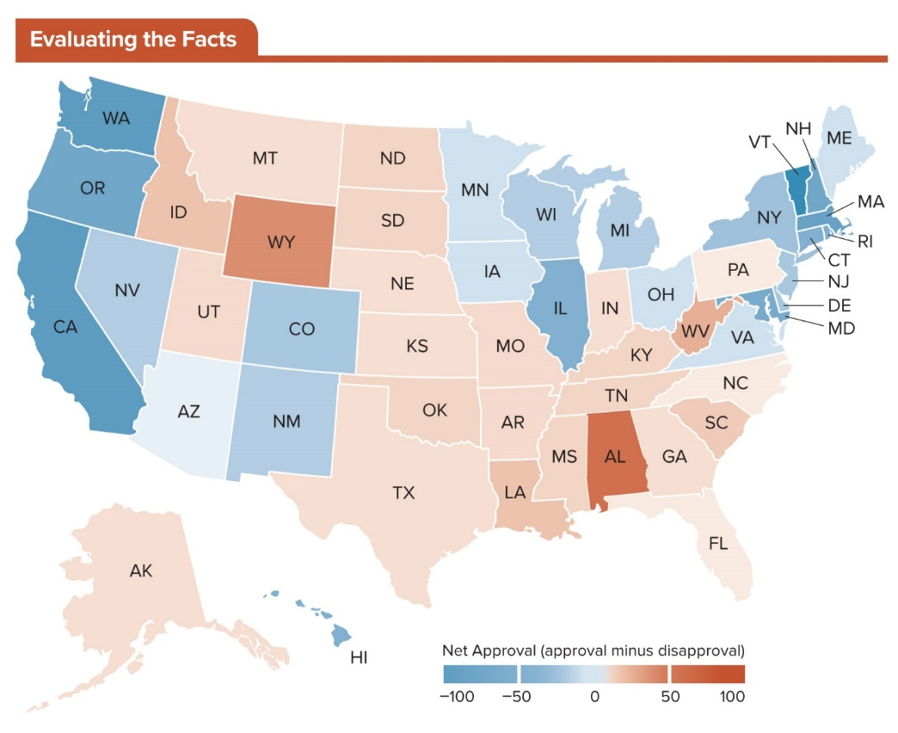
Figure 13.3 Approval of President Donald Trump Varies from State to State
In 2020, Trump’s approval rating varied greatly from state to state. For example, only 29 percent of Vermonters approved of the president’s job performance, but 61 percent of West Virginians did.
Access the text alternative for slide images.
SOURCE: Gallup

Slide 42
Technology and the Media as Tools of Presidential Influence
Modern presidents rely heavily on technology and the mass media to convey their message to the people.
For every president, technology and the media can be used as tools of influence, as the expertise of the White House communications office can “spin” news in a favorable light for the administration.

Slide 43
The Evolution of Presidential Power
Constitutional powers of the presidency have changed little over time, but the power of the presidency has evolved a great deal.
Skillful use of the power of persuasion, asserting more authority, and the political environment have contributed to the evolution of presidential power.
Imperial presidency: the modern executive branch and the enormous political power the office has gained through assertion, the size of the bureaucracy, and the presence of staff loyal to an individual president.

Slide 44
Early Presidents and the Scope of Presidential Power
Thomas Jefferson broadened the powers of the office despite his Anti-Federalist reluctance.
Established the principle of inherent powers.
Twenty-five years later, Andrew Jackson would also adopt the role of president-as-party-leader.
Added an emphasis on populism.
Franklin Roosevelt’s New Deal dramatically changed people’s views of the role of the federal government.
Provider of a “safety net” through popular programs like unemployment insurance and Social Security.

Slide 45
The Watershed 1970s: The Pentagon Papers, Watergate, and the “Imperial Presidency”
Americans’ penchant for strong presidents modeled after Roosevelt diminished drastically in the 1970s through a series of embarrassing and sometimes illegal executive branch scandals.
Pentagon Papers: leaked history of the nation’s involvement in Vietnam from Truman to the Nixon administration.
Watergate: a scandal involving burglaries and the subsequent cover-up.
Watergate dramatically demonstrated how enormously the presidency had changed.

Slide 46
The Post-Watergate Presidency
Mild-mannered Jimmy Carter, when elected president, was thought to be the antidote to Nixon’s presidency.
Many believe Carter didn’t exercise enough authority.
Ronald Reagan had a more powerful presidency.
George W. Bush administration was best at re-creating a form of imperial presidency.
Terror attacks and activist foreign policy.
Analysts faulted Barack Obama’s conciliatory, consensus-building nature as an impediment to exercising strong authority.

Slide 47
Impeachment: A Check on Abuses of Presidential Power 1
Crucial check on presidential power: impeachment.
Impeachable offenses: “Treason, Bribery, or other high Crimes and Misdemeanors.”
If the House votes to impeach the president, they forward the charges against the president, called the articles of impeachment, to the Senate.
Senate then holds a trial, and if convicted, the president can be removed from office.

Slide 48
Impeachment: A Check on Abuses of Presidential Power 2
Three presidents have been impeached by the House of Representatives.
Andrew Johnson.
Bill Clinton.
Donald Trump.
None have been convicted and removed from office.
Nixon resigned from office to avoid the inevitability of impeachment proceedings in the wake of the Watergate scandal.

Slide 49
Women and the Presidency
Hillary Clinton’s 2016 candidacy was historic, but her failure to win represents a stark political reality concerning the difficulty of any woman to win the most powerful position in the world.
Historically, Americans were unwilling to vote for a qualified woman for president, but those times seem to be mostly past.

Slide 50
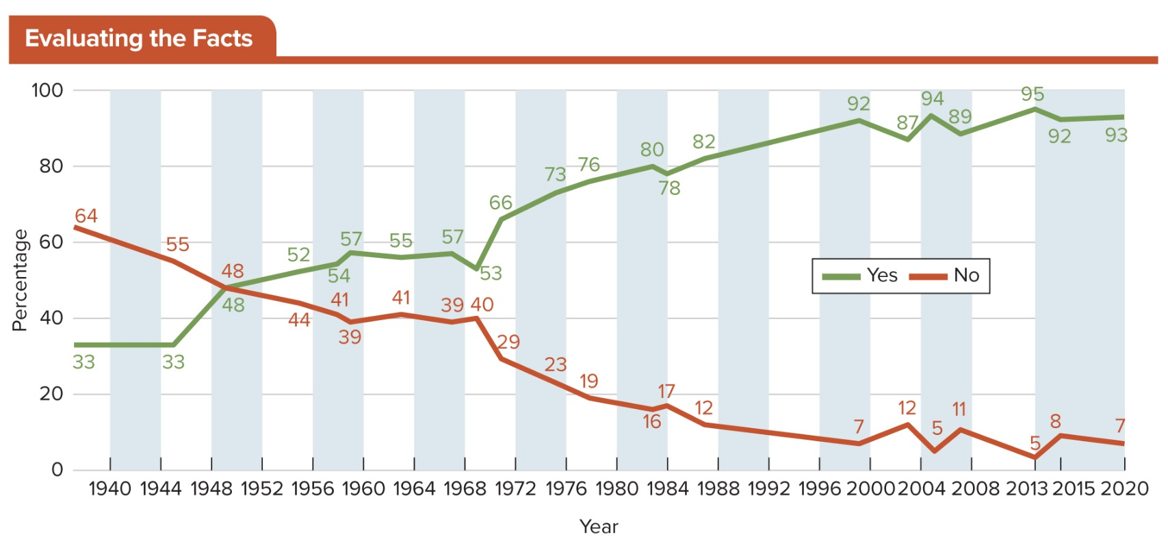
Figure 13.4 America’s Willingness to Vote for a Woman President
In 1937, only 33 percent of Americans said they would vote for a qualified woman, but the figure has risen steadily. By 2013, 95% were saying they would vote for a female candidate. Small downticks in the past few years may be a result of the unpopularity of Hillary Clinton as the supposed candidate.
SOURCES: Roper Center for Public Opinion Research and Gallup

Slide 51
The First Lady
Much like the presidency itself, the office of the first lady has been defined by its occupants.
Some first ladies have used their proximity to influence policy, while others were more reserved.
Like the first ladies that came before her, Melania Trump, a modern mother who once worked as a model, is shaping the office to her own personality and her marriage.

Slide 52
Review 1
Then—Presidential power grew over the centuries to “imperial” proportions and then ebbed in the late 20th century in the wake of scandals.
Now—A new controversial president exercises presidential power in new and unprecedented ways.

Slide 53
Review 2
Next:
Will President Trump unify a divided American electorate?
Will future presidents use technology in an unfettered and unfiltered manner?
Has President Trump forever changed the presidency, or will it revert to the traditional institution it once was?

Slide 54
End of Main Content
Copyright 2022 © McGraw Hill LLC. All rights reserved. No reproduction or distribution without the prior written consent of McGraw Hill LLC.

Slide 55
Accessibility Content: Text Alternatives for Images

Slide 56
Figure 13.1 Presidential Vetoes, 1789 to 2020 – Text Alternative
Return to parent-slide containing images.
Bar graph showing the number of regular vetoes issued by a president (beginning with George Washington) and the number that were overridden by Congress. Franklin D. Roosevelt has issued more regular vetoes (372) than any other president and only nine were overridden. President Cleveland comes in second with 304 regular vetoes, while President Truman issued 180. Eight presidents, including John Adams, Thomas Jefferson and James Garfield, did not issue a single veto during their presidency.
Return to parent-slide containing images.

Slide 57
Figure 13.2 The Departments of the President’s Cabinet – Text Alternative
Return to parent-slide containing images.
The departments are: Department of Justice (www.justice.gov), Department of Agriculture (www.usda.gov), Department of Commerce (www.commerce.gov), Department of Defense (www.defense.gov), Department of Education (www.ed.gov), Department of Energy (www.energy.gov), Department of Health and Human Service (www.hhs.gob), Department of Homeland Security (www.dhs.gov), Department of Homeland Security (www.dhs.gov), Department of Housing and Urban Development (www.hud.gov), Department of Veteran Affairs (www.va.gov). Department of the Interior (www.doi.gov), Department of Transportation (www.dot.gov), Department of the Treasury (www.treasury.gov), and Department of State (www.state.gov).
Return to parent-slide containing images.

Slide 58
Figure 13.3 Approval of President Donald Trump Varies from State to State – Text Alternative
Return to parent-slide containing images.
The provinces are marked for approval in the following categories:
The data where net approval is approval minus disapproval is as follows:
Negative 100 to negative 50:
It includes states of Washington, Oregon, California, Illinois, Vermont, New Hampshire, Massachusetts, Connecticut, Rhode Island, and Maryland.
Negative 50 to 0:
It includes states of Nevada, Arizona, Colorado, New Mexico, Hawaii, Minnesota, Iowa, Wisconsin, Michigan, Ohio, Virginia, New York, New Jersey, Delaware, and Maine.
0 to 50:
It includes states of Montana, Idaho, Utah, Alaska, North Dakota, South Dakota, Nebraska, Kansas, Oklahoma, Texas, Missouri, Arkansas, Louisiana, Indiana, Kentucky, Tennessee, Mississippi, Pennsylvania, Wyoming, North Carolina, South Carolina, Georgia, and Florida.
50 to 100:
It includes states of Alabama and Wyoming.
Return to parent-slide containing images.

